Slide 1
Financial Condition Analysis
December 8, 2022
Wenchen Wang

Slide 2
Last Week – Financial Statement Analysis
Financial Statement Analysis Definition
Financial Statement Analysis Process and Steps
Appropriate Ratio Analysis
Notes:
Financial Statement Analysis: Tries to answer a series of questions about an organization’s mission, financial stability, and operating results. Managers may want to understand their organization’s financial position and results of operations so that they can make decisions that will maintain a satisfactory financial situation or improve an unsatisfactory one. Vendors want to understand whether their customers will be able to pay for their purchases. Lenders want to consider the likelihood of an organization being able to repay loans. State governments use financial information for oversight of local governments.
Process:
The auditor’s opinion
Financial statement and notes
Prepare the appropriate ratios and analyze
When possible, get comparative data
Organization over time
Organization’s peer
Industry
Organize the information and complete the analysis.

Slide 3
This Week- Financial Condition Analysis
Financial Condition Analysis Definition
Financial Condition Analysis Process and Steps
Appropriate Ratio Analysis
Notes:
When we talk about financial statement analysis, we are targeting at all NFP organizations. However, understanding the financial condition of governments requires additional types of information, and in some cases modifications to the financial statement analysis

Slide 4
Financial Condition
Governments:
Taxes and service fees are the main sources of revenue
Limited ability to increase tax rates
Demand for safety-net services increase and tax receipts go down in an economic downturn
Notes:
Government is unique comparing to other NFP organizations such as charities since it is sometimes harder to see the potential problem. Tax and service fees are the main sources of revenue, and it is expected that if there is a deficit or shortage, governments can just raise the tax and services fees to increase their revenues.
however, that state and local governments have limited ability to raise taxes. The citizens are not wealthy enough to support unlimited tax increases. Some governments have tax limitations in place. Many local governments require state approval to increase taxes, and states may not be willing to give such approval. Nor is such an approach politically feasible.
More common is the case that economic downturns reduce tax receipts and user fees just when the demands for safety-net services are rising.
Therefore, an analysis of the financial status of a governmental organization is a relevant and appropriate activity for both managers of the government and interested individuals and organizations outside the government. Such analysis is referred to as financial condition analysis.

Slide 5
Financial Condition Analysis
Builds from Financial Statement Analysis but goes further for government
It includes a broader array of considerations:
Political, Economic, Social, and Demographic
It looks at whether a government will be able to meet:
Its financial obligations
Its constituent service obligations
It is complicated by the use of modified accrual and fund accounting
The financial condition of each fund may be analyzed separately
Notes:
Berne has defined financial condition as follows: “The probability that a government will meet both (a) its financial obligations to creditors, consumers, employees, taxpayers, suppliers, constituents, and others as they become due; and (b) the service obligations to constituents, both currently and in the future.”
As discussed in Week 11 unique aspects of GOV, it uses modified accrual and fund accounting:
Under modified accrual accounting, a government recognizes revenues when it has a current financial resource inflow, meaning when the revenue is measurable and available within a short period of time, normally within a year. Resource outflows are expenditures rather than expenses, and expenditures are recognized when resources are acquired (four stage of encumbrance, acquisition, use, and payment)
Fund accounting is to divide accounting records into separate sub-entities, and we have three types of governmental funds, proprietary funds and fiduciary funds.
In general, financial condition analysis is more extensive and more complex compared with financial statement analysis.

Slide 6
Financial Condition Analysis Process
The auditor’s opinion
Financial statements (CAFR) and notes
Prepare appropriate ratios and analyze
When possible, get comparative data
Government over time
Similar governmental organizations
Organize the information and complete the analysis.
Extract as much information as possible
Look for potential problem areas
Notes:
The fundamentals of financial statement analysis still apply. The financial statements should be carefully reviewed. The audit letter should be examined. The notes that accompany the financial statements should be evaluated. Ratios should be calculated. Comparisons should be done both over time and across similar governmental organizations.

Slide 7
Government Financial Report
Governmental Financial Reporting
Management’s Discussion & Analysis (MD&A)
Required Supplementary Information (RSI)
Basic Financial Statements (BFS)
Government-Wide Financial Statements
Fund Financial Statements
Notes to the financial statements
Statement of Net Position
Statement of Activities

Slide 8
Comprehensive Annual Financial Report (CAFR)
Contains the financial statements of the government but often provides supplemental information:
The Management Discussion and Analysis contains a wide variety of information (MD&A);
The statistical section gives economic and demographic trends as well as trends in revenues, expenditures, and debt;
The basic financial statement (BFS) provides information for government-wide statement as well as separate fund financial statements
The required supplemental information (RSI) presents the budgetary comparison schedule on the budgetary basis of accounting
Notes:
The textbook refer to this as The Annual Comprehensive Financial Report (ACFR) but they are the same thing.
The MD&A provides an objective and easily understandable analysis; Provides an analysis of the overall condition of the government; Discusses material events and their potential impact on financial condition.
The statistical section also provides a wealth of information for financial condition analysis. It presents detailed data on the government’s financial trends, revenue capacity (revenues by source; tax collections), expenditures (expenditures by function) debt capacity (ratio of annual debt service; bonded debt per capita), demographic and economic characteristics, and operations. Generally, these data must show 10-year trends in the variables.
The BFS include some statements prepared on the accrual basis (general, proprietary, and fiduciary) and some statements prepared on the modified accrual basis (government fund).
Financial condition analysis can be very complex because of the cumbersome information included in the CAFRs. We are not going to dive into each of the components of the CAFR to learn how to do financial condition analysis.

Slide 9
Financial Condition Analysis
Financial Condition Analysis
Relies on comparisons
Time series analysis
With other jurisdictions
When comparing:
Make sure that the governments being compared are comparable
Compare the specific and the aggregate revenue and expenditures
Factor differences in demographics and local economic conditions into your analysis
Notes:
Time series analysis: Forecast the city’s fiscal status for the next five years

Slide 10
Context
Context
 | Minneapolis | Detroit
 | 2018 | 2018
Population | 425,403 | 672,662
Population change (2010-2018) | 11.2% | -5.8%
Unemployment rate | 2.7% | 5.2%
Poverty Rate | 19.9% | 36.4%
Education level (% >25 years with bachelor’s degree) | 49.4% | 14.6%
Per capita income | $37,071 | $17,338

Slide 11
Ratios in Financial Condition Analysis
Ratios in Financial Condition Analysis
Common size ratios
Liquidity Ratios
Budgetary solvency
Long-run solvency
Service-level solvency
Efficiency ratios
Other ratios
Solvency ratios
Notes:
For financial condition analysis, some ratios need to be modified, others eliminated, and yet others added to create a solid analysis.

Slide 12

Liquidity Ratio
Liquidity Ratio
Ability to generate sufficient cash to pay for current liabilities
$$Cash Ratio=\frac{Cash and cash equivalent+Marketeable Securities}{Current liabilities}$$
$$Quick Ratio=\frac{Cash and cash equivalent+Marketeable Securities+Receivables}{Current liabilities}$$
$$Current Ratio=\frac{Current Assets}{Current liabilities}$$
Notes:
Liquidity ratios are based on information from the balance sheet or statement of net position. Focus on whether an organization has enough cash and liquid resources to meet near-term obligations. Can we meet our current obligations when they are due?

Slide 13
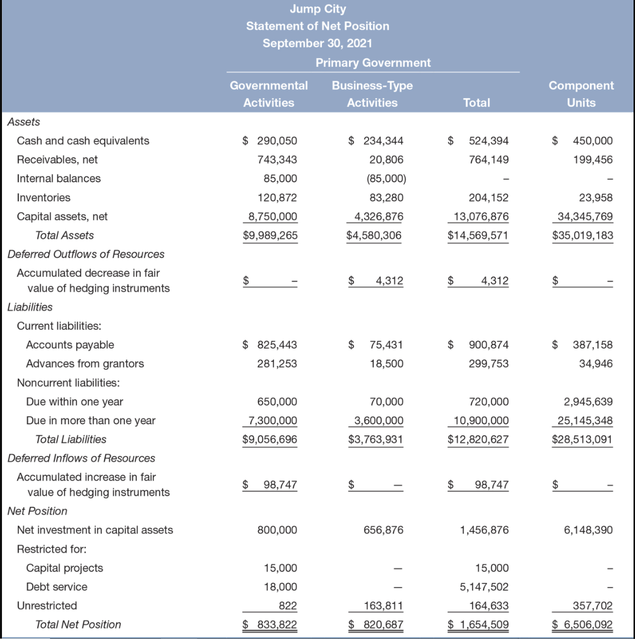


Current Ratio - Example
Current Ratio - Example
What is the current ratio for the Total column?
$$Current Ratio=\frac{Current Assets}{Current liabilities}$$
$$Current Ratio=\frac{\text{Cash} \text{+} \text{Receivables} \text{+} \text{Inventories}}{\begin{aligned}\text{Accounts} \text{Payable} \text{+} \text{Advances} \text{from} \text{Grantors} \text{+} \\ \text{Noncurrent} \text{Liabilities} \text{Due} \text{Within} \text{One} \text{Year} \text{+} \\ \text{Deferred} \text{Inflows} \text{of} \text{Resources} \end{aligned}}$$
$Current Ratio=\frac{\text{524,394} \text{+} \text{764,149} \text{+} \text{204,152}}{\text{900,874} \text{+} \text{299,753} \text{+} \text{720,000} \text{+} \text{98,747}}=$ 0.74
Notes:
Should deferred outflows of resources and deferred inflows of resources be included in this ratio? The timing for these deferred inflows and outflows is often unclear from the financial statements. However, a conservative approach would be to exclude deferred outflows from the numerator of the current ratio and to include deferred inflows in the denominator.
The governmental fund financial statements are useful for liquidity analysis. Since the governmental fund financial statements are based on current financial resources, there is less guesswork involved in determining what is or is not a current asset or liability.
Which column to use for the ratio analysis depends on what question you want to address:
If a user is concerned about potential obligations to pay for debt of the component units, analyses may focus on the information in the Component Units column.
If an analysis is being performed to determine the financial health of the enterprise funds, then the focus might be on the Business-Type Activities column.
Proprietary fund: business-like basis: Enterprise fund: Governmental units that provide goods and services to individual organizations: Sewer, water, mass transit; internal service funds: provide services to other governmental units
General fund: Day-to-day revenues and expenditures. Routine and ordinary activities of the government (governmental funds)

Slide 14
Common Size Ratios
Common Size Ratios
Compare all the numbers on a financial statement to one key number
Proportion / Relative Size
Such analysis should be done for all columns in the statements (e.g., Governmental Activities, Business-Type Activities) unless the analysis is being targeted to some specific questions that require more limited data.
Are helpful for comparison with other governments
Notes:
A common size ratio compares all the numbers on a financial statement with one key number. For example, each asset on the balance sheet is compared with total assets. Each item on the activity statement is compared with total revenues.
Common size ratios are usually shown as a percentage. Rather than referring to the cash holdings of the museums as being 0.2, or one tenth of total assets, we indicate that their cash is 20 percent.
Common size ratios allow for comparisons among other organizations of differing sizes and between an organization and the whole industry. They normalize comparisons.
The common size cash ratio should be neither too high nor too low. Too low a ratio indicates a possible inability to pay obligations when due. Too high a ratio indicates surplus cash that could have been used to provide services, reduce high-cost debt, or invest in higher-yielding investments.
Again, there is no rule of thumb. Appropriate values differ by industry. We must consider the trend over time and the values at other organizations.

Slide 15


Budgetary Solvency
Budgetary Solvency
Ability to collect sufficient revenues to pay for expenditures/ expenses
$$Operating Ratio=\frac{Total Revenue}{Total expenditure}$$
Sufficiency of revenues to cover expenditures
$$Own Source Ratio=\frac{Revenue from own sources}{Total Revenue}$$
Level of revenue that comes from a government’s own sources (taxes, fees)
These are considered to be more stable and controllable by the government
Notes:
In financial statement analysis, we talked about solvency ratios. We talked about leverage ratios (debt and debt to equity ratios), which examine the use of debt to finance acquisition of assets; We also talk about coverage ratios (time of interests earned and cash flow coverage), which examine organization’s capacity to make payments.
Here we also discuss a list of solvency ratios for the government.

Slide 16
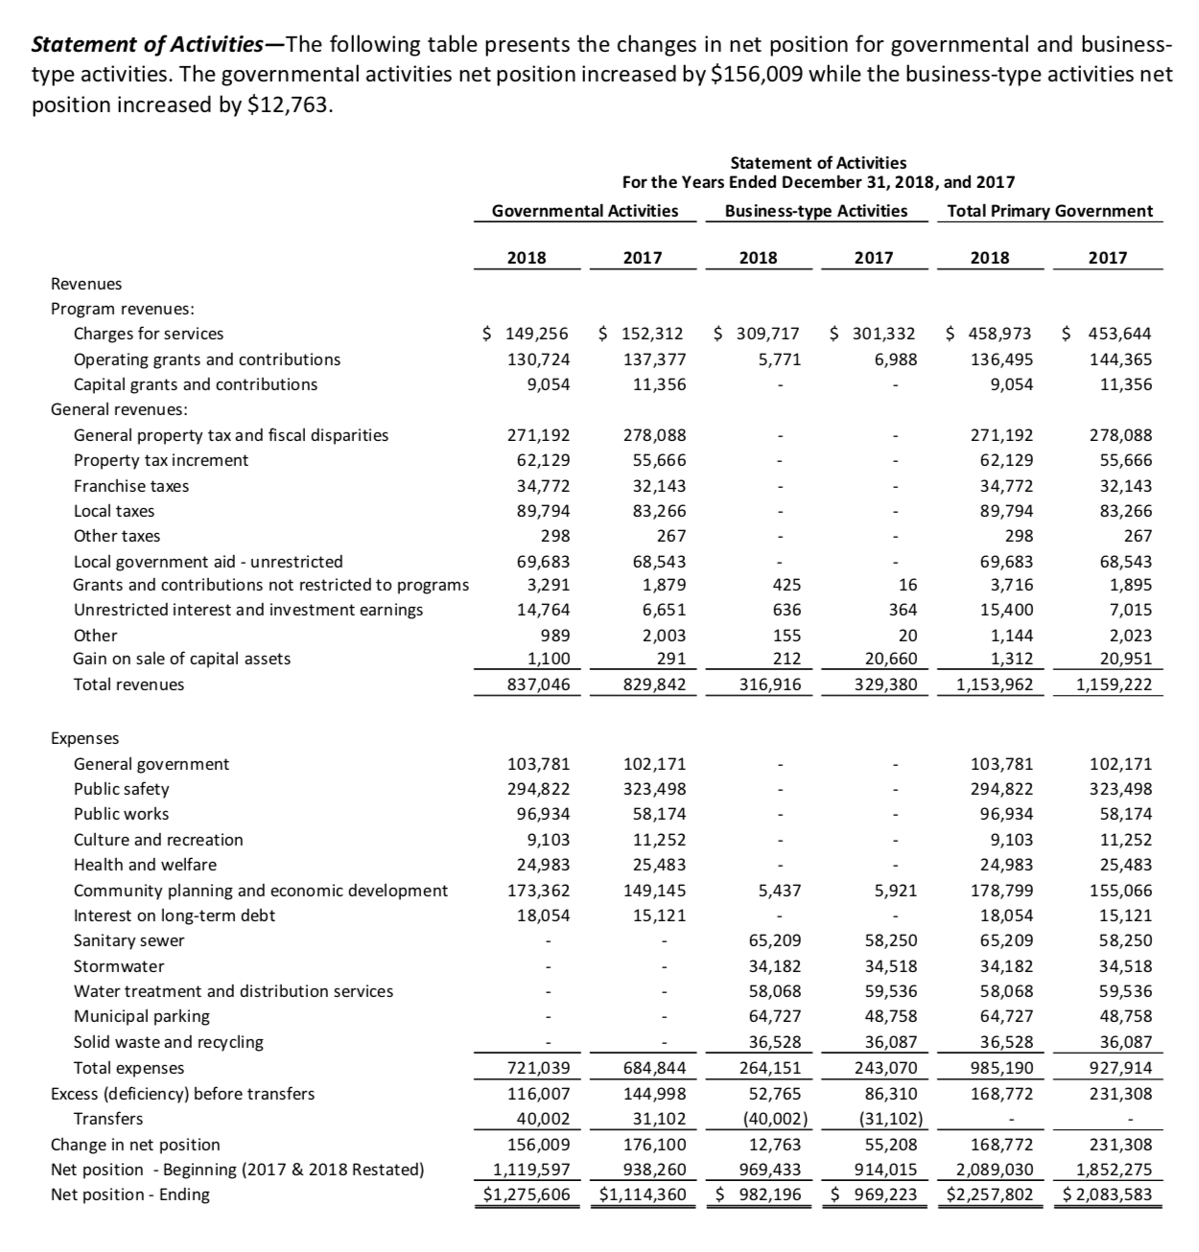
Budgetary Solvency
Budgetary Solvency

Slide 17
Long-Run Solvency
Long-Run Solvency
Ability to pay long-term obligations
$$Long−Term Debt Ratio=\frac{Total long term debt}{Total Assets}$$
Ability to pay off long-term debt
$$Long−Term Debt Per capita=\frac{Total long term debt}{Population}$$

Slide 18
Budgetary Solvency
Long-run Solvency

Slide 19
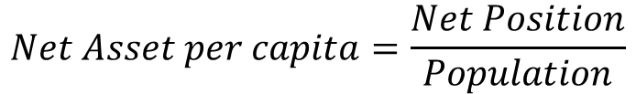

Service-Level Solvency
Service Level Solvency
Ability to support a desirable level of service
$$Net Asset Ratio=\frac{Net Position}{Total Asset}$$
Assesses the extent of a government’s ability to support services as well as withstand financial emergencies
$$Net Asset per capita=\frac{Net Position}{Population}$$

Slide 20
Budgetary Solvency
Service Level Solvency

Slide 21

Efficiency Ratios
Efficiency Ratios
Property Tax Collection Ratio: The proportion of the taxes billed in a given year that are collected
$$Tax Collection Ratio=\frac{Current Year Property Tax Collected}{Current Year Property Tax Levy}$$
Notes:
What portion of the taxes billed in a given year is collected? The higher the percentage of this year’s property taxes that are collected this year, the stronger the financial condition of the government, other things being equal.

Slide 22
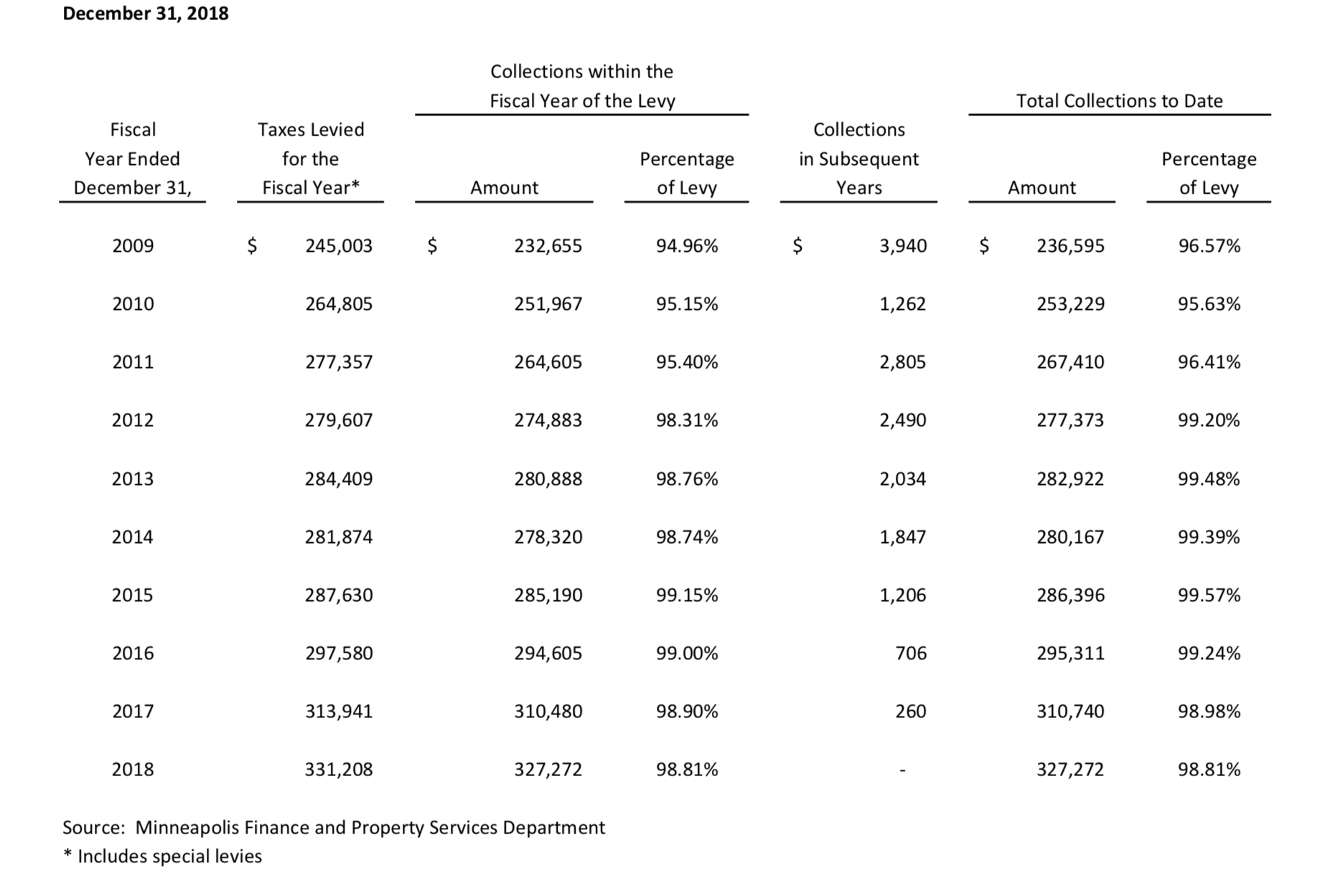

Slide 23

Efficiency Ratios
Efficiency Ratios
Cost Burden Ratio: Expenses per capita or per $1,000 of income
$$Cost Burden Ratio=\frac{Government Expenses}{Population or Income}$$

Slide 24
Risk Analysis in Financial Condition Analysis
Risk Analysis
It involves looking at:
The reliability of individual revenue sources (the risk exposure factor)
The ability of the government to increase resources in the event of a shortfall (tax leverage factor)
Notes:
Risk exposure looks at the relative dependence of the government on a single source of revenue and whether it has been stable over time.
Tax leverage factor looks at how heavily a single economic resource in the tax base and the total of all elements of the tax base have been taxed. Lower comparable rates suggest higher capacity for tax increases.
Service ratios measure how much of a specific service is being delivered to the constituency on a per capita basis. Low comparable numbers may mean that there is pent-up demand for services that is not being met by the government.
Example: low per capita expenditures on police or fire services combined with high per capita crime rates or incidents of property loss to fire.

Slide 25
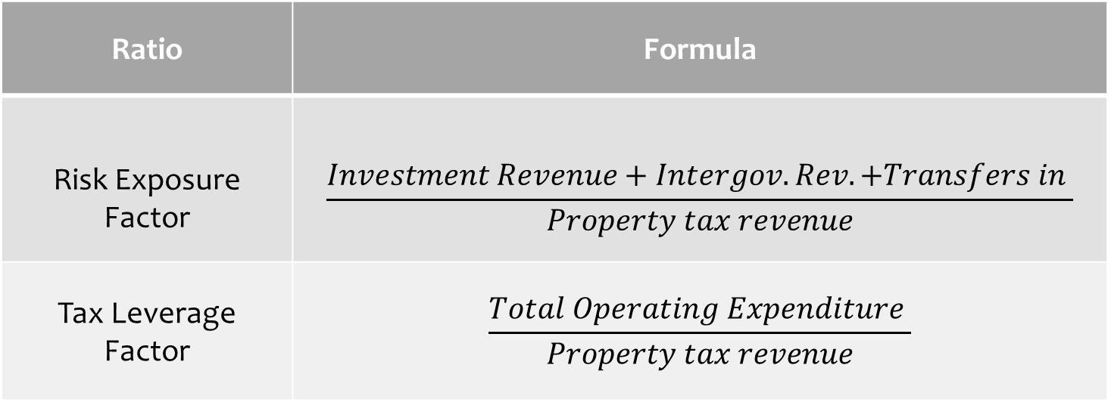
Risk Analysis
Ratio | Formula
Risk Exposure Factor | $$\frac{Investment Revenue+Intergov. Rev.+Transfers in }{Property tax revenue}$$
Tax Leverage Factor | $$\frac{Total Operating Expenditure }{Property tax revenue}$$
Notes:
If risk exposure factor = $2,000,000/$10,000,000 = 0.2, this would imply that if uncontrollable money (the numerator) fell 10 percent from $2 million to $1.8 million, own source revenues (the denominator) would have to rise 2 percent to make up the difference (i.e., 0.2 × 10% = 2%). This government does not rely heavily on intergovernmental aid and would not suffer greatly if that aid were cut.
If risk exposure factor = $20,000,000/$10,000,000 = 2, this would imply that if the numerator fell 10 percent, own revenue sources such as property taxes would have to rise 20 percent to make up the difference (2 × 10% = 20%). This heavy reliance on revenues outside the direct and full control of the government is a further concern because the factors that cause declines in those revenues, such as a weak economy, often make it difficult for local governments to raise tax rates. A government with heavy reliance on such revenues should have surpluses and build reserves in good times that can be used in times of intergovernmental aid decreases, thus avoiding significant local tax increases.
The tax leverage factor, defined previously, indicates the amount taxes must increase in response to expenditure increases. For example, if the government spends $30 million a year and has just $10 million of its own revenue sources, then a 1 percent increase in spending, with no other revenue increases, would require a 3 percent increase in the local tax collections. That is, if spending goes up 1 percent, or $300,000, there would have to be a 3 percent increase in controllable government revenues (3 × 1% = 3%).

Slide 26
Other Ratios
Other Ratios
Total Revenues Per Capita
Total Expenditures Per capita
Operating Expenditures/Total Expenditures
Current Liabilities/Operating Revenues
Unfunded Pension Liabilities/Net Assessed Property Value

